Slide 1

Submission of Project-II Semester: 4 “Title of your project”
Member : 1
Name: Hardik Vaviya
Enrollment no: 170510101083
Member : 2
Name: Shubham Shukla
Enrollment no:170510101092
Member : 3
Name:Kalp Zaveri
Enrollment no:170510101086
PICA- BCA & IMCA

Slide 2
Introduction
This system is used to manage the bank system which is used by us. As we know that India has the largest number of customer in a banking sector.
In this banking system there are 3 login places such as admiration , customer and employee.
In this several account type with its feature and several different facilities is available.
It also have useful link where we can find the link useful for the customer.
It also provides loan facilities for the customer.

Slide 3
Existing System
•Our banking management system is work inside the computer system of bank.
•Our system have three type of user.1)Admin 2) Customer 3) Employee.
•With the admin control admin can create id and password for customer control and employee control and also view information about customer a/c and transaction.
•With the customer control they can 1)Create Account 2)Update Account 3) view reports etc…
•With the employee control employee can perform transaction, view reports, generate OTP, View transaction.

Slide 4
Drawbacks of Existing System
PROBLEMS WITH EXISTING SYSTEM
Lack of security of data.
Time consuming.
Consumes large volume of paper work.
Needs manual calculations.
No direct role for the higher officials.
Damage of machines due to lack of attention.

Slide 5
Functions of new system
Banking calculator.
Online information about auction of properties .

Slide 6
Tools and Technologies used
Technologies we are going to use such as asp.net with c# as backend code.
In the front we use basic HTML with CSS.
Tools used such as laptop.

Slide 7
SystemUsers
1.Administrator.
2. Employee.
3.Customer.

Slide 8
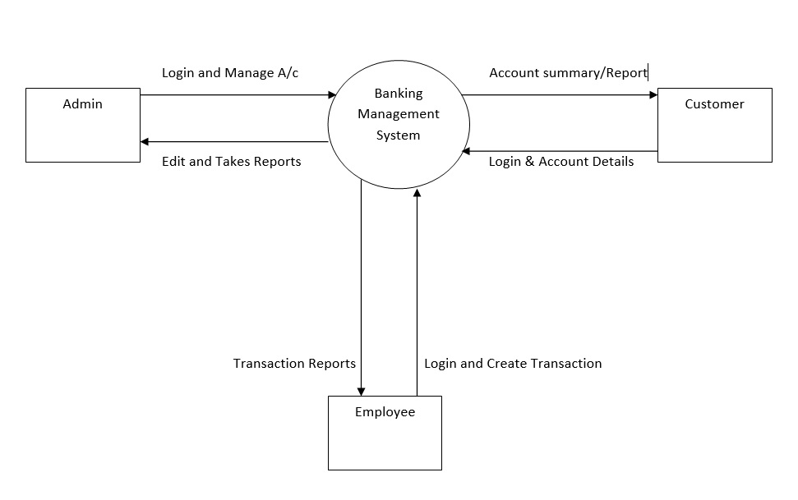
Context level DFD

Slide 9
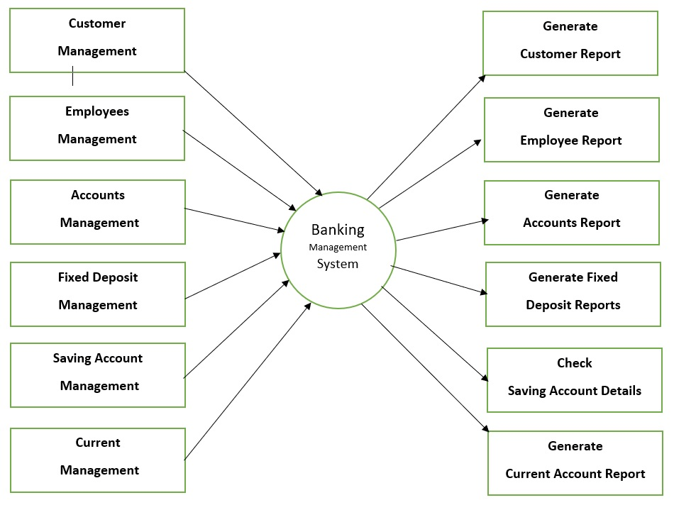
1st level DFD

Slide 10
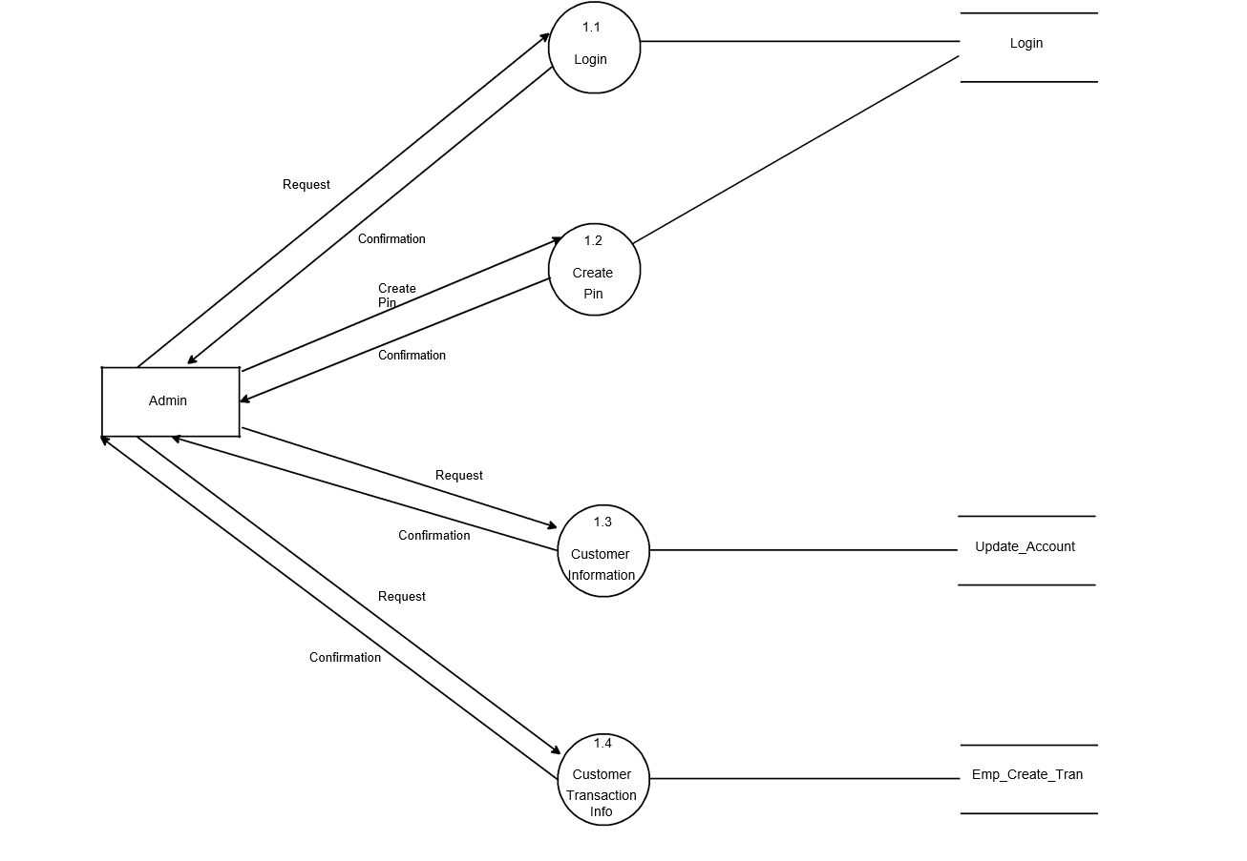
2nd level DFD

Slide 11
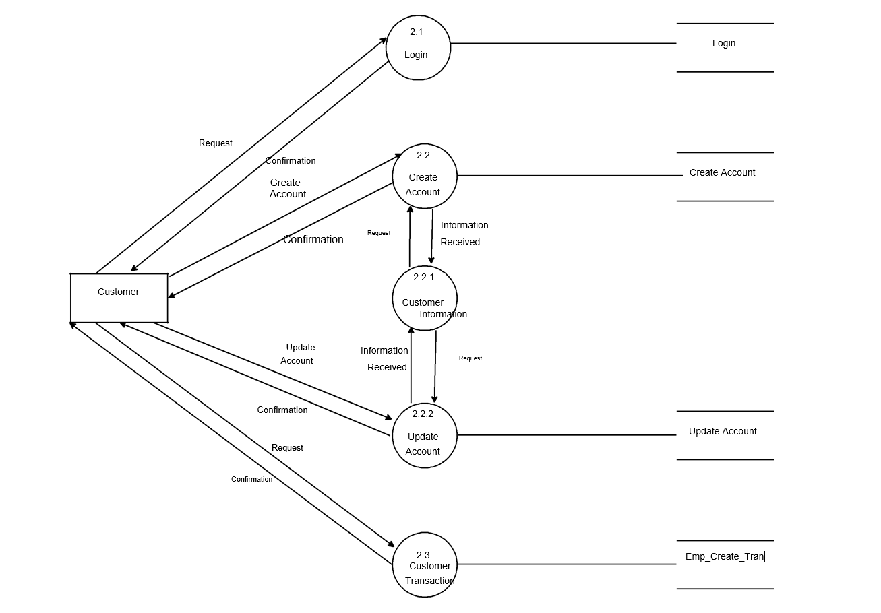
2nd level DFD

Slide 12
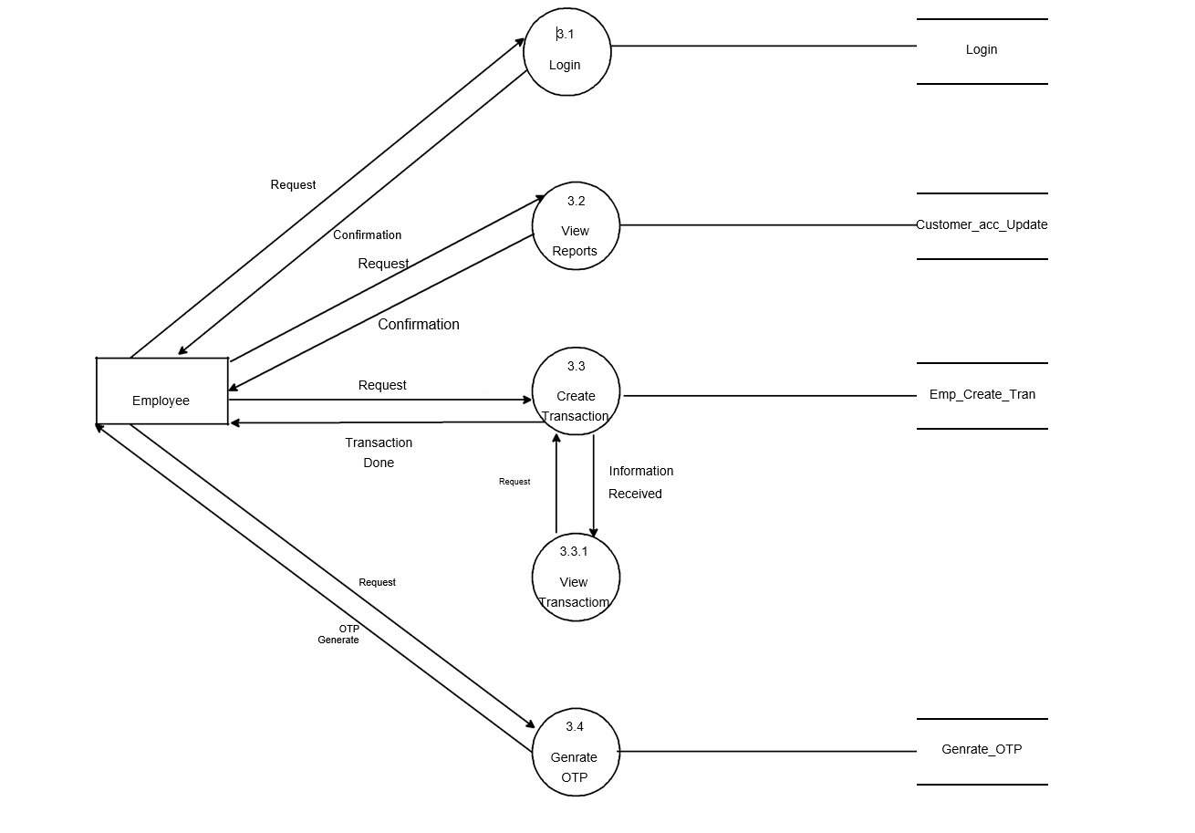
2nd level DFD

Slide 13
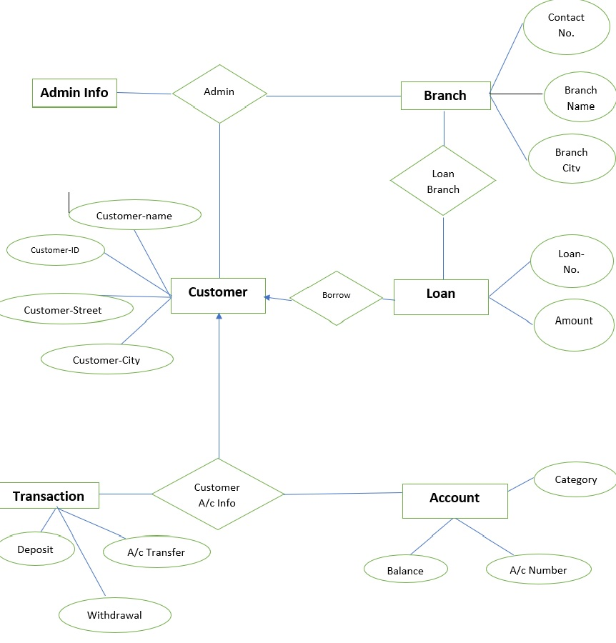
E-R Diagram

Slide 14
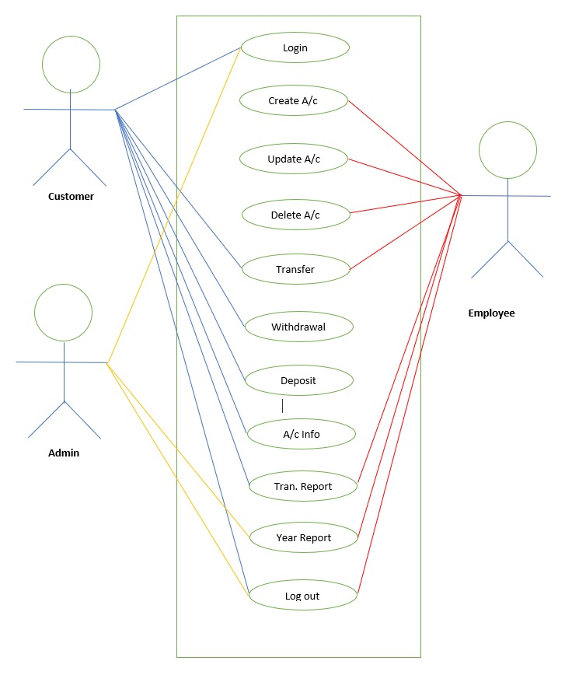
Use Case Diagram

Slide 15
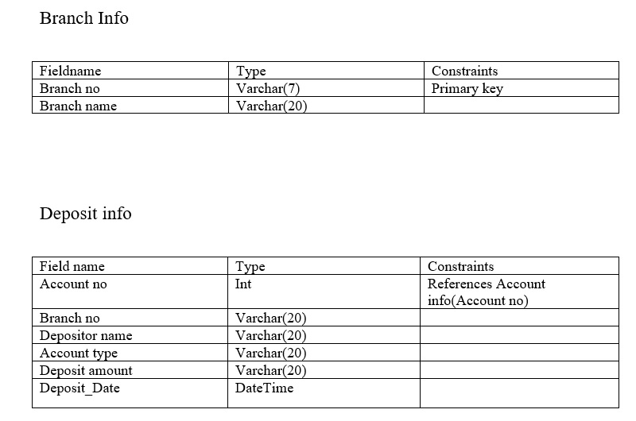
Data Dictionary

Slide 16
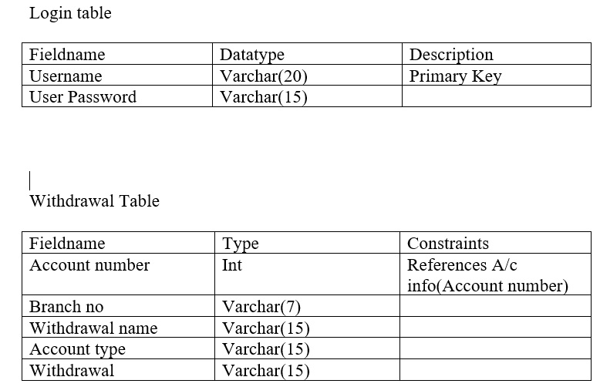
Data Dictionary

Slide 17
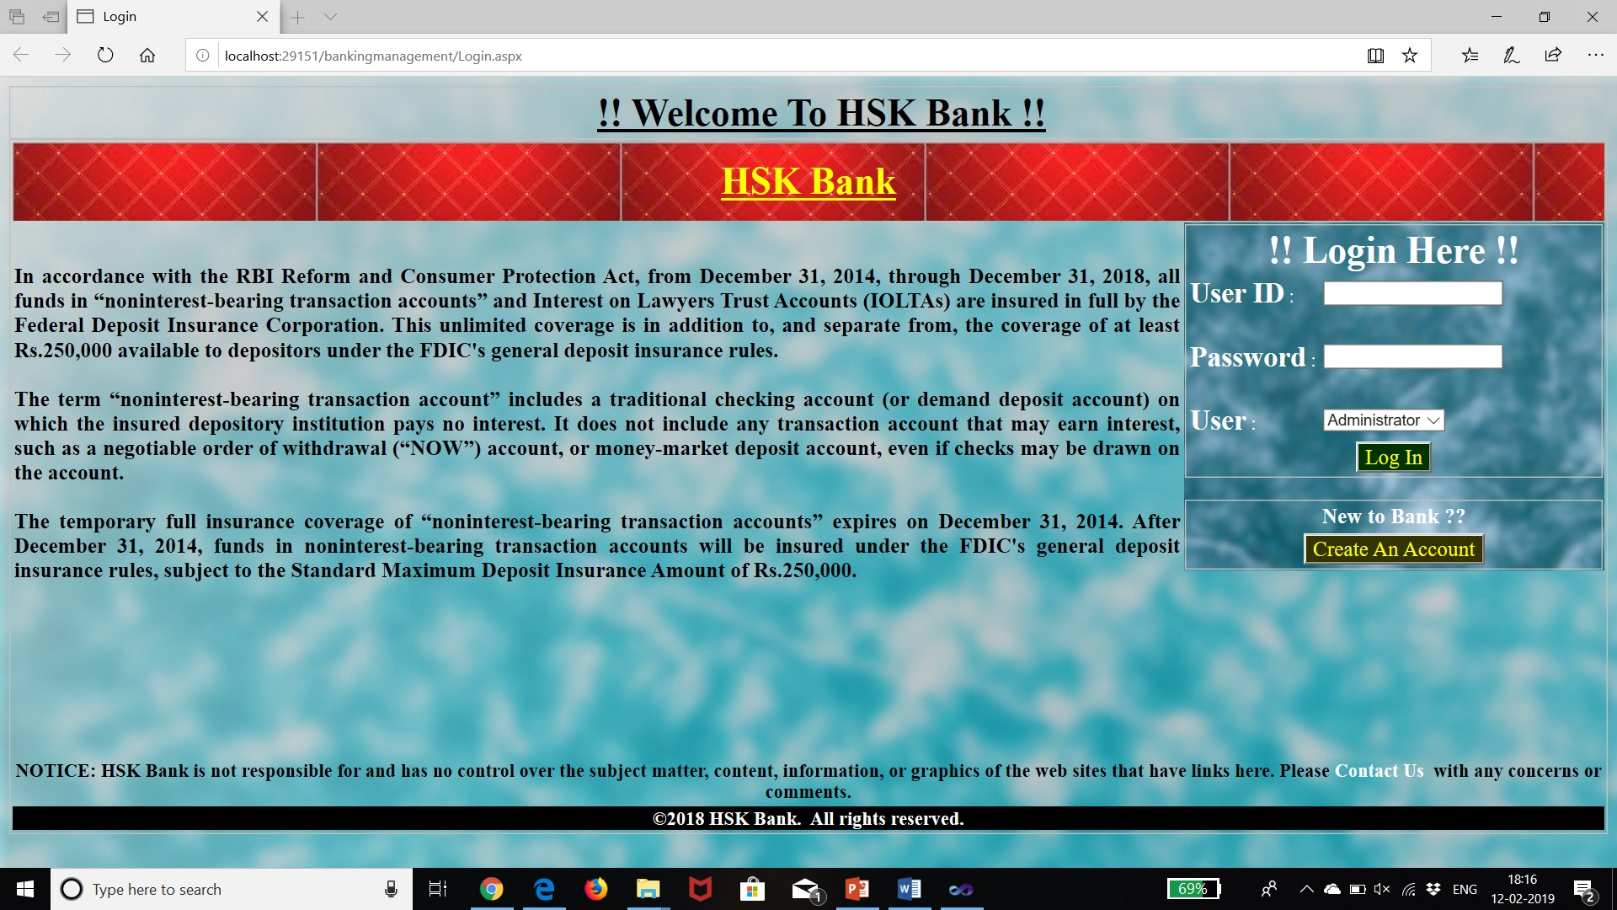
Screenshots
Put screenshots and explain in two three lines

Slide 18
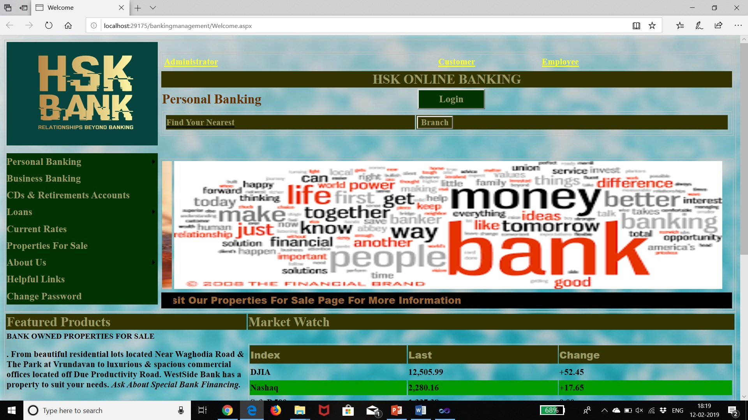
Coding of main functionality-1

Slide 19
Future Enhancement
Current status of project: -This project is now wards complete but we can add more things like ATM, Online Transactions through Online Banking.
Remaining areas of concern: -This software project is complete and can be used to access records, can generate reports whenever necessary or needed.
Technical and managerial lessons learnt: - During the development of project we have learnt many lessons like the rules prevailing within an organization like: -
Proper defined structure.
Good chain of commands.
Work should be divided among each other.
Effective and efficient environment for working and development.
Future recommendations: -As we all know that the change is permanent, so according to change this project can be modified or manipulated according to needs.

Slide 20
Thank you!!!

